Slide 1
Cash Free
A Student Utility Android Application Designed for CHARUSAT
From: Mikin Patel (14CE098)
Varsh Patel (14CE107)

Slide 2
Why Android ?
More than 75% student at charusat campus uses android devices.
It is the widest OS used in mobile devices.
As we know, it’s a open source platform.
Increasing popularity around the globe.

Slide 3
A Thought !
Sometimes student forget to get wallet from their home.
This utility app provides credits per studentID for the cash they have paid to the admin.
Later this credits can be used at canteen, stationery and library as per their need on campus.

Slide 4
Cash Free
Cash Free is a student utility app designed for CHARUSAT specifically.
Student can pay cash to admin and get equivalent credits for their ID.
Later this credits will be used by the student at canteen, stationery and library as per his/her requirements.
A student can refill there credits again by giving cash to admin.
Student can view their entire transaction in show credits option.
About page includes the information on developer and guide from CHARUSAT.

Slide 5
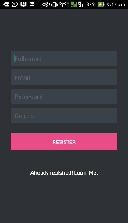
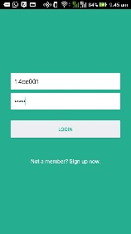
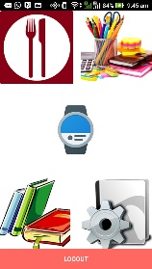
GUI

Slide 6
In Addition
Student can create their account by registering provided with their StudentID, Name and Password.
Login must be provided with genuine credentials.
Student can get the remaining credits notification on the wear connected to the device.
Students can get notification if they are running low on credits.

Slide 7
Features
Encryption of password before storing on to database.
Instant update of credits onto database at every transaction.
Student can view their entire transaction to keep a track.
High mobility due to wear connect.

Slide 8
How ?
Application in made in android studio.
PHP support on backend for database management with MySQL.
Hosted onto WAMP3.0.0 server currently running on this laptop.

Slide 9
Assumptions
Assumption made for this project is the database is handled by the CHARUSAT administration.
So at the end of every month the respected credits onto canteen, stationery and library account is paid to them via admin.
Making overall account to NULL for canteen, stationery and library after money paid to them.

Slide 10
Limitations
Currently, this app is designed for CHARUSAT campus.
Available only for android platform.
Virtual server by WAMP is used.

Slide 11
Future Scope
This database can be put up online or on WINCELL Intranet for CHARUSAT.
More university can be collaborated to the app by providing one more option to choose university at registration module.
This app can be made available to cross platforms i.e. IOS, BlackBerry, etc.

Slide 12
Thank You..!
Also extending my thanks to the rising technology in android that made me to select this project with great passion.

